Slide 1
Application Guide Renewal of licence
How to apply and document that you meet the requirements for a Nordic Swan Ecolabel licence.

Slide 2
Introduction
Contents
The application process
Step 1: Sign in and change your password.
Step 2: Create your renewal application request.
Step 3: Document that you meet the requirements.
Step 4: Submit your application.
This guide helps you create a renewal application and document that you meet the new requirements for a Nordic Swan Ecolabel Licence.
Please read the guide carefully before you start creating the application and document that you meet the requirements.
Keep the guide as a support when working with your application.
When Nordic Ecolabelling introduces new features, this guide may be updated. Check that you have the latest version on our website.
Version 2.0

Slide 3
The application process
How to apply and document that you meet the requirements for a Nordic Swan Ecolabel licence.
1.
Sign in and change your password.
2.
Create your renewal application request.
3.
Document that you meet the requirements.
4.
Submit your application.

Slide 4
1. Sign in and change your password.
Please use Microsoft Edge or Google Chrome as web browser.
Please sign in here: Nordic Ecolabelling Portal
The Portal Terms & Conditions appear the first time you log in.

Slide 5
1. Sign in and change your password.
Please note!
Never use Google translate.
You need to accept the Terms & Conditions to proceed.

Slide 6
1. Sign in and change your password.
Once you have signed in, you will see this view.
Here you can find all the ongoing applications for your company.
You will also find information about all the licences, licenced products, contacts and brands registered in your company account.
The terms and conditions and links to the Nordic Ecolabelling international website and all our national websites can also be found here.

Slide 7
The application process
How to apply and document that you meet the requirements for a Nordic Swan Ecolabel licence.
1.
Sign in and change your password.
2.
Create your application request.
3.
Document that you meet the requirements.
4.
Submit your application.

Slide 8
2. Create your renewal application request.
Please click Application and View application and select the application with Type Renewal you would like to renew.

Slide 9
2. Create your renewal application request.
Select the application you would like to renew by clicking the blue ID Number link and open the renewal application.

Slide 10
2. Create your renewal application request.
The Renewal Licence No you find in Applicant´s naming of application, can be changed to a suitable application name for your company.
Please use Applicant´s description to describe your application.
Enter the name of the production site.
Also specify if there is any information we need to add to the invoice for your company.

Slide 11
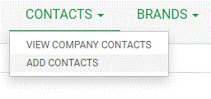
2. Create your renewal application request.
Please select a Primary Application Contact who is assigned responsibility for this specific application.
Then select a Primary Licence Contact. It could be the same individual or someone else who is responsible for all the licences on your company´s portal account.
If a contact in your company is missing from the list, please select Contacts in the top menu and then select Add contacts.

Slide 12
2. Create your renewal application request.
Please, select a Marketing Contact, who is responsible for your use of the Nordic Swan Ecolabel when you have received a license.
Then select a Finance Contact, responsible for reporting the annual turnover of the products included in your licences.
Select the currency for your invoice in the Currency field.
Do not fill in the Estimated Annual Turnover fields.

Slide 13
2. Create your renewal application request.
Please read the Regulations carefully.
Then tick the boxes to confirm that your company accepts and complies with them.
The Sign & create application button becomes dark green and activated when both boxes are ticked.
Click Sign & create application to continue.

Slide 14
2. Create your renewal application request.
The renewal application request is now created and provided with an Application ID Number and an Application status.
The application is sent to Nordic Ecolabelling and the application fee will be invoiced.
Click Continue application to proceed.
Please note!
The number separator must be a decimal point. Don´t use decimal comma.

Slide 15
The application process
How to apply and document that you meet the requirements for a Nordic Swan Ecolabel licence.
1.
Sign in and change your password.
2.
Create your renewal application request.
3.
Document that you meet the requirements.
4.
Submit your application.

Slide 16
3. Document that you meet the requirements.
To deselect a product that should not be part of the Renewal of your licence, click on the icon for Please cancel.
The product changes status to Please cancel, and will no longer be a part of the Renewal of your licence.

Slide 17
3. Document that you meet the requirements.
Click the blue link with the product name in the Name column to open the Requirements view and document that the product meet the new requirements.

Slide 18
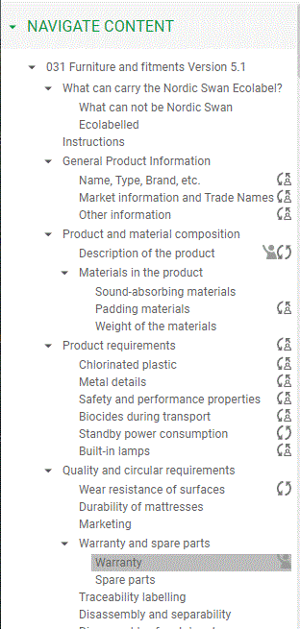
3. Document that you meet the requirements.
The Navigate content section gives you an overview when responding to the requirements.
When you start documenting how you meet the requirements, a status icon appears in the navigation bar.
By clicking on a heading in the navigation bar, you will come to that section. You can also scroll through the text in all the sections.
By clicking on the arrows you can show and hide sections.

Slide 19
3. Document that you meet the requirements.
Please, remember to use Save.
Only use the Close button if you don’t want to save any changes.
Use Save & close to get back to the product overview.
Click New Message to write a message or note next to the section. If you write a question, click on the symbol with a raised hand so that it turns green for help. If you do not receive an answer quickly enough, you are always welcome to contact us.

Slide 20
3. Document that you meet the requirements.
Document that you meet the requirements by answering the questions in each section. When a document is requested, click Add document reference(s) and connect relevant files from your Document Library to the section, or upload and connect a new file.
When you are done, click the drop-down list next to the heading and change the status description from In progress by applicant to Ready for evaluation.
Proceed to the next section.

Slide 21
The application process
How to apply and document that you meet the requirements for a Nordic Swan Ecolabel licence.
1.
Sign in and change your password.
2.
Create your application request.
3.
Document that you meet the requirements.
4.
Submit your application.

Slide 22
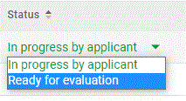
4. Submit your application.
Please change the status of each product from In progress by applicant to Ready for evaluation.
Click Submit for evaluation to notify Nordic Ecolabelling that your application is ready for an Evaluator to work with.

Slide 23
Published by Nordisk Miljömärkning / Nordic Ecolabelling Box 38114 SE-100 64 Stockholm Phone: +46 (0)8 55 55 24 00 E-mail: info@nordicecolabelling.org Website: www.nordic-swan-ecolabel.org Copyright © Nordic Ecolabelling 2022 Bildmaterial: Unsplash

